Slide 1
Discrete Probability
CMSC 250

Slide 2
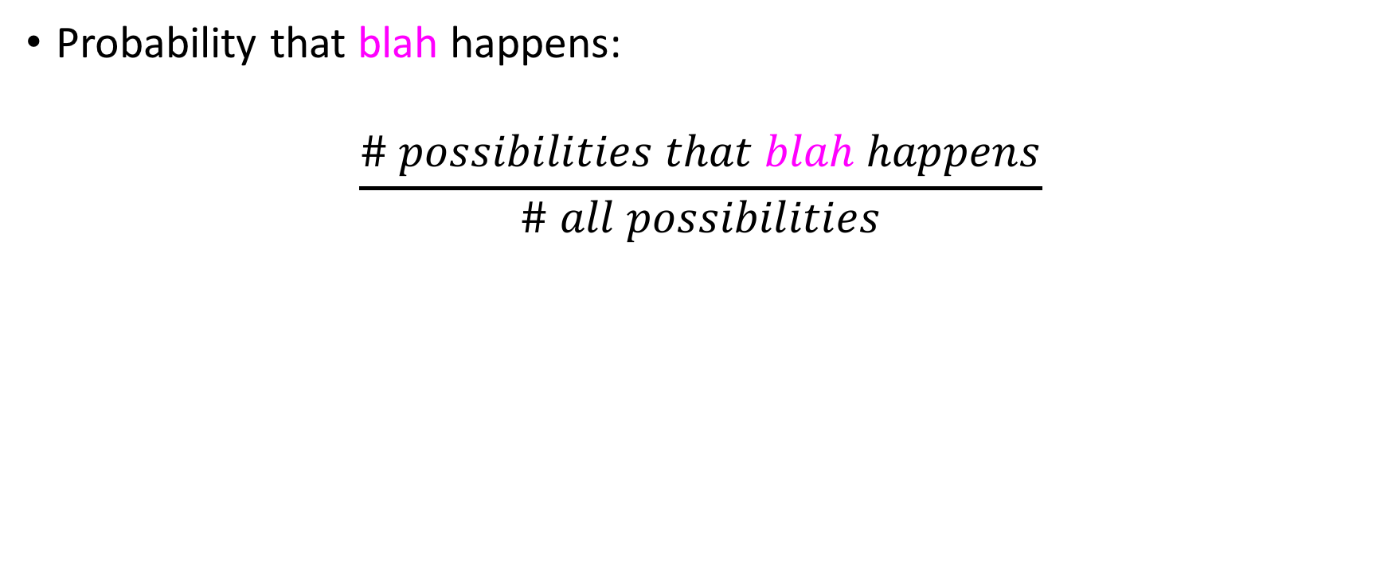
Informal definition of probability
Probability that blah happens:
$$\frac{\# possibilities that blah happens}{\# all possibilities}$$

Slide 3
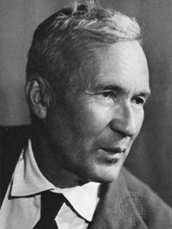
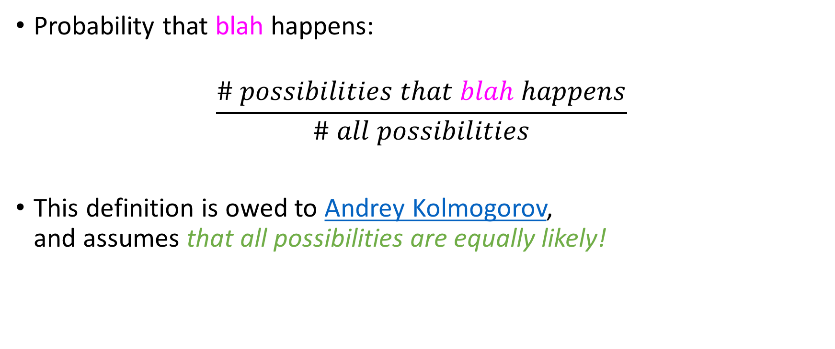
Informal definition of probability
Probability that blah happens:
$$\frac{\# possibilities that blah happens}{\# all possibilities}$$
This definition is owed to Andrey Kolmogorov, and assumes that all possibilities are equally likely!

Slide 4
First examples
Experiment #1: Tossing the same coin 3 times.

Slide 5
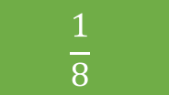
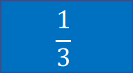
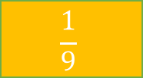
First examples
Experiment #1: Tossing the same coin 3 times.
What is the probability that I don’t get any heads?
$$\frac{1}{3}$$
$$\frac{1}{8}$$
$$\frac{1}{9}$$
Something else

Slide 6

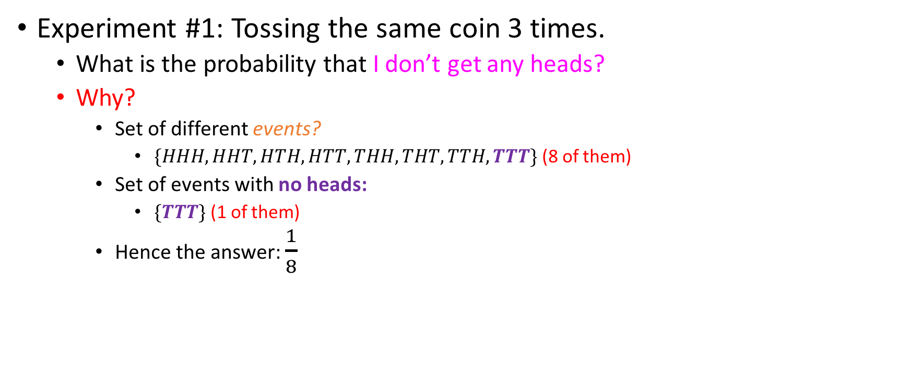

First examples
$$\frac{1}{3}$$
$$\frac{1}{8}$$
Experiment #1: Tossing the same coin 3 times.
What is the probability that I don’t get any heads?
Why?
Set of different events?
$\{HHH, HHT, HTH, HTT, THH, THT, TTH, TTT\}$ (8 of them)
Set of events with no heads:
$\{TTT\}$ (1 of them)
Hence the answer: $\frac{1}{8}$
$$\frac{1}{9}$$
Something else

Slide 7
First examples
$$\frac{1}{3}$$
$$\frac{1}{8}$$
Experiment #1: Tossing the same coin 3 times.
What is the probability that I don’t get any heads?
Why?
Set of different events?
$\{HHH, HHT, HTH, HTT, THH, THT, TTH, TTT\}$ (8 of them)
Set of events with no heads:
$\{TTT\}$ (1 of them)
Hence the answer: $\frac{1}{8}$
$$\frac{1}{9}$$
Something else
Implicit assumption: all individual outcomes (HHH, HHT, HTH, ….) are considered equally likely (probability 1/8)

Slide 8
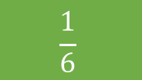
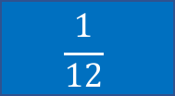
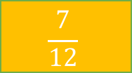
Practice
Experiment #2: I roll two dice.
Probability that I hit seven = ?
$$\frac{1}{12}$$
$$\frac{1}{6}$$
$$\frac{7}{12}$$
Something else

Slide 9
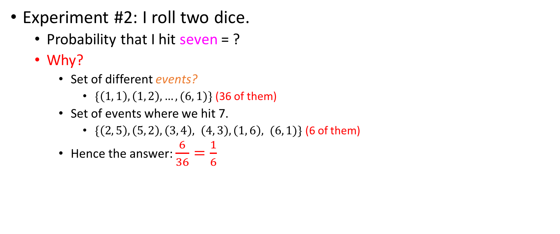
Practice
Experiment #2: I roll two dice.
Probability that I hit seven = ?
Why?
Set of different events?
$\{\left(1, 1\right), \left(1, 2\right), …, (6, 1)\}$ (36 of them)
Set of events where we hit 7.
$\{\left(2, 5\right), \left(5, 2\right), \left(3, 4\right), \left(4, 3\right), \left(1, 6\right), (6, 1)\}$ (6 of them)
Hence the answer: $\frac{6}{36}=\frac{1}{6}$
$$\frac{1}{12}$$
$$\frac{1}{6}$$
$$\frac{7}{12}$$
Something else

Slide 10
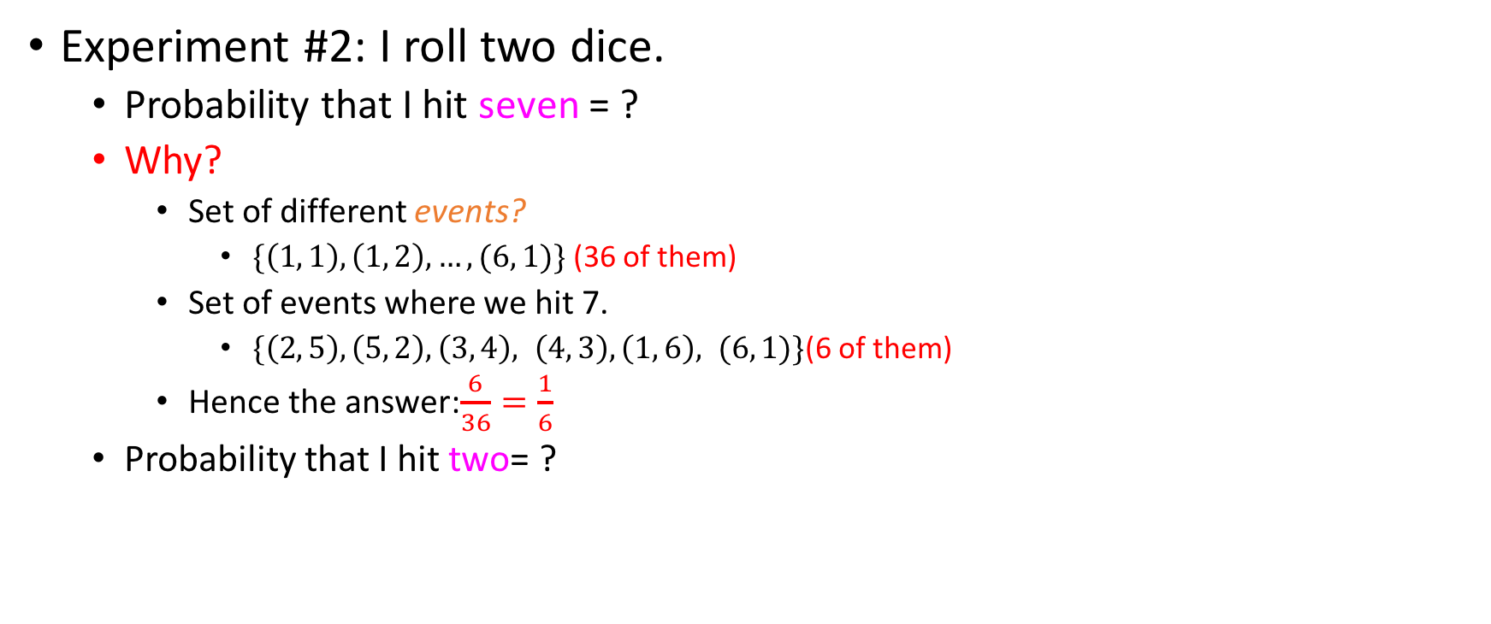
Practice
Experiment #2: I roll two dice.
Probability that I hit seven = ?
Why?
Set of different events?
$\{\left(1, 1\right), \left(1, 2\right), …, (6, 1)\}$ (36 of them)
Set of events where we hit 7.
$\{\left(2, 5\right), \left(5, 2\right), \left(3, 4\right), \left(4, 3\right), \left(1, 6\right), (6, 1)\}$(6 of them)
Hence the answer:$\frac{6}{36}=\frac{1}{6}$
Probability that I hit two= ?
$$\frac{1}{12}$$
$$\frac{1}{6}$$
$$\frac{7}{12}$$
Something else
$$\frac{1}{12}$$
$$\frac{1}{6}$$
$$\frac{7}{12}$$
Something else

Slide 11
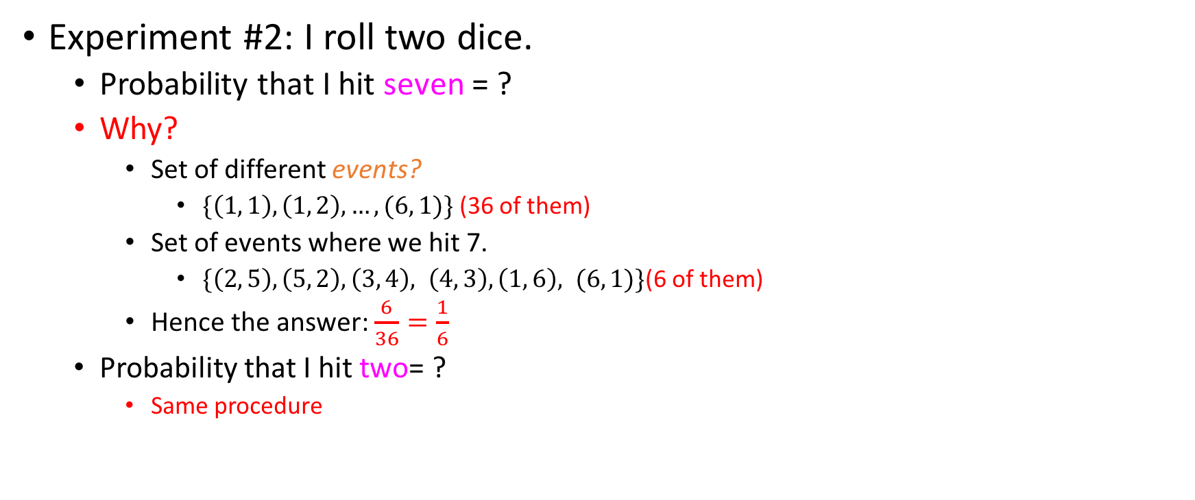
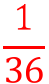
Practice
Experiment #2: I roll two dice.
Probability that I hit seven = ?
Why?
Set of different events?
$\{\left(1, 1\right), \left(1, 2\right), …, (6, 1)\}$ (36 of them)
Set of events where we hit 7.
$\{\left(2, 5\right), \left(5, 2\right), \left(3, 4\right), \left(4, 3\right), \left(1, 6\right), (6, 1)\}$(6 of them)
Hence the answer: $\frac{6}{36}=\frac{1}{6}$
Probability that I hit two= ?
Same procedure
$$\frac{1}{12}$$
$$\frac{1}{6}$$
$$\frac{7}{12}$$
Something else
$$\frac{1}{12}$$
$$\frac{1}{6}$$
$$\frac{7}{12}$$
Something else
$$\frac{1}{36}$$

Slide 12
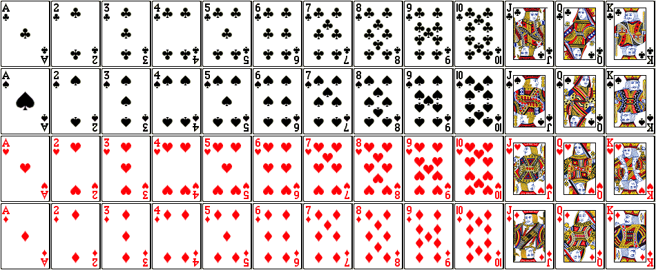
Poker Practice
Full deck = 52 cards, 13 of each suit:

Slide 13
Poker Practice
Full deck = 52 cards, 13 of each suit:
Flush: 5 cards of the same suit
What is the probability of getting a flush?

Slide 14
Probability of a flush
How many 5-card hands are there?

Slide 15
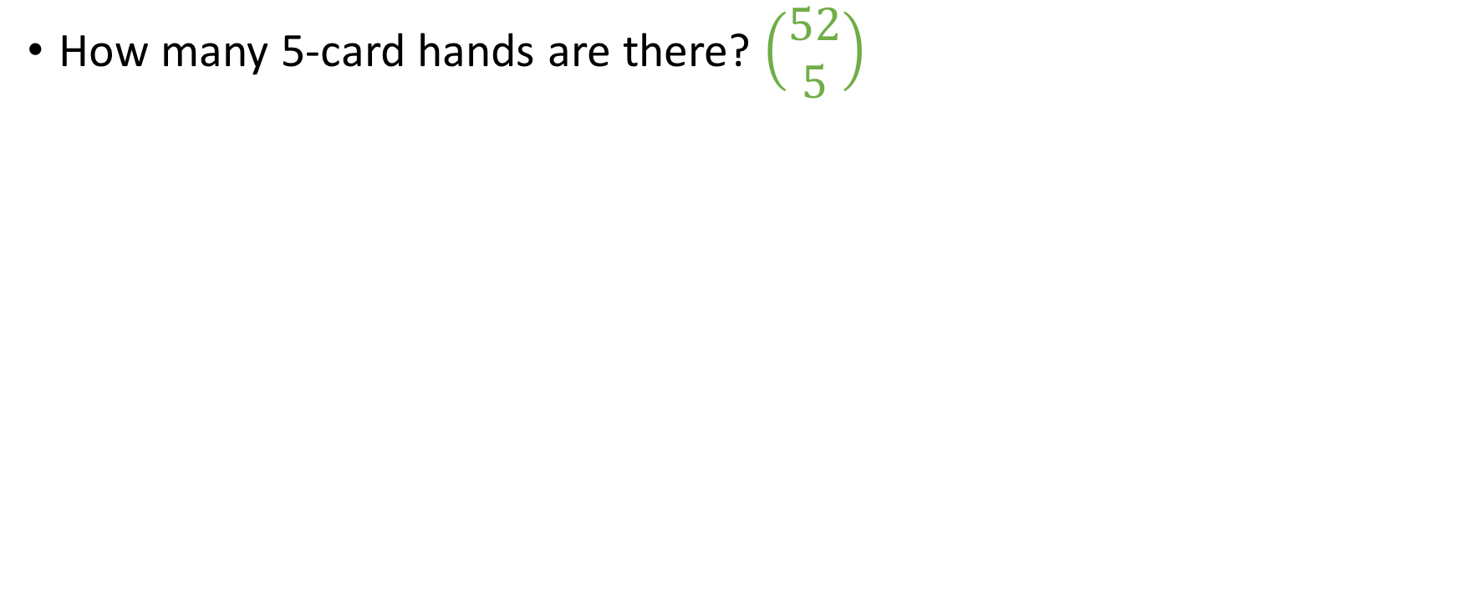
Probability of a flush
How many 5-card hands are there? $\left(\begin{aligned}52 \\ 5\end{aligned}\right)$

Slide 16
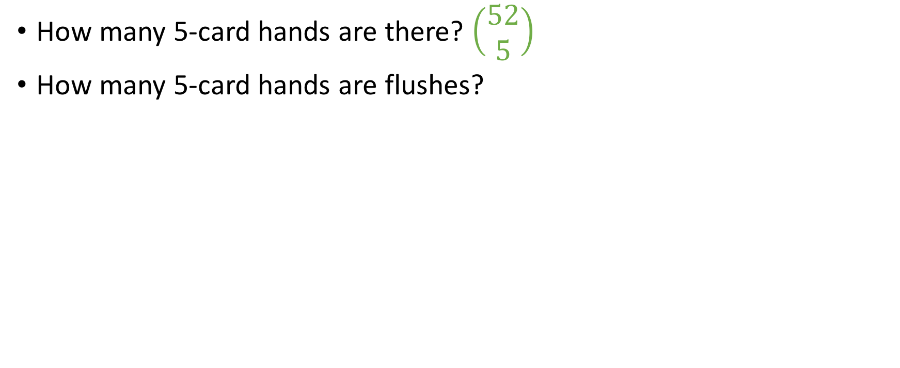
Probability of a flush
How many 5-card hands are there? $\left(\begin{aligned}52 \\ 5\end{aligned}\right)$
How many 5-card hands are flushes?

Slide 17
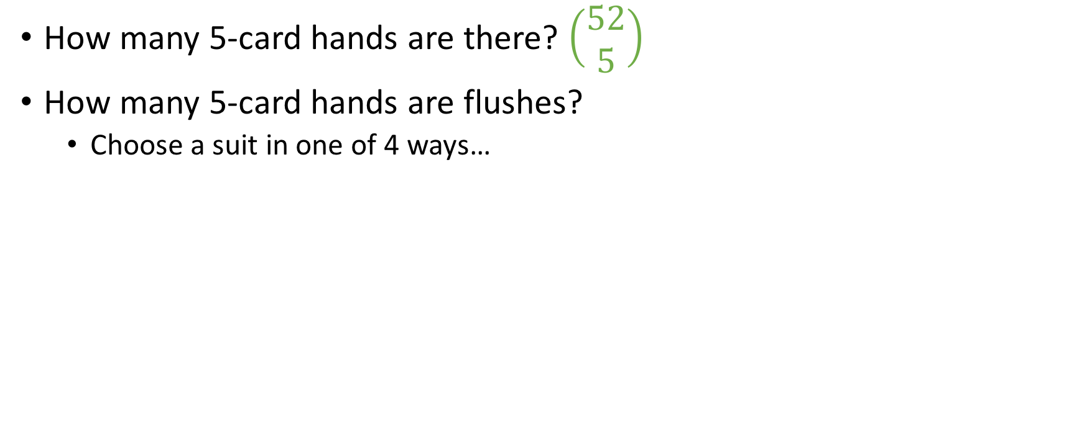
Probability of a flush
How many 5-card hands are there? $\left(\begin{aligned}52 \\ 5\end{aligned}\right)$
How many 5-card hands are flushes?
Choose a suit in one of 4 ways…

Slide 18
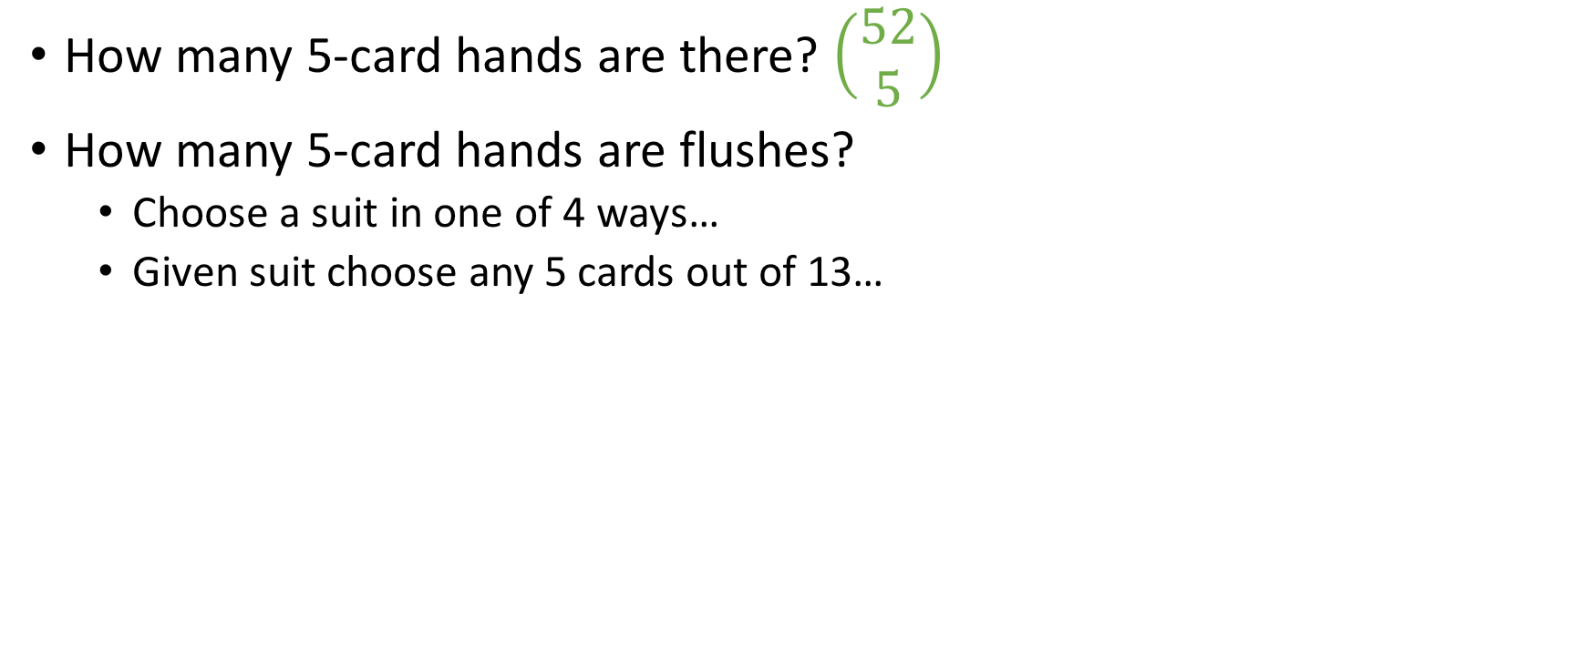
Probability of a flush
How many 5-card hands are there? $\left(\begin{aligned}52 \\ 5\end{aligned}\right)$
How many 5-card hands are flushes?
Choose a suit in one of 4 ways…
Given suit choose any 5 cards out of 13…

Slide 19
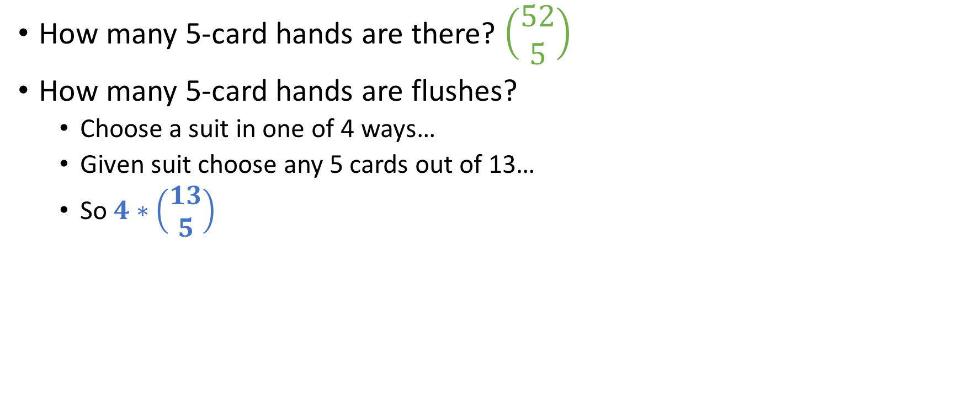
Probability of a flush
How many 5-card hands are there? $\left(\begin{aligned}52 \\ 5\end{aligned}\right)$
How many 5-card hands are flushes?
Choose a suit in one of 4 ways…
Given suit choose any 5 cards out of 13…
So $4∗\left(\begin{aligned}13 \\ 5\end{aligned}\right)$

Slide 20
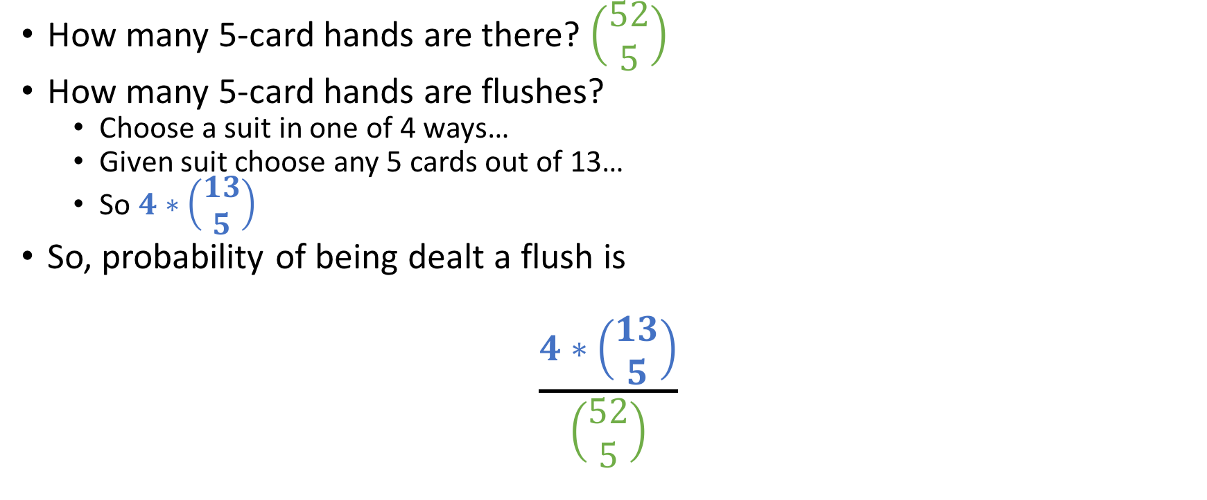
Probability of a flush
How many 5-card hands are there? $\left(\begin{aligned}52 \\ 5\end{aligned}\right)$
How many 5-card hands are flushes?
Choose a suit in one of 4 ways…
Given suit choose any 5 cards out of 13…
So $4∗\left(\begin{aligned}13 \\ 5\end{aligned}\right)$
So, probability of being dealt a flush is
$$\frac{4∗\left(\begin{aligned}13 \\ 5\end{aligned}\right)}{\left(\begin{aligned}52 \\ 5\end{aligned}\right)}$$

Slide 21
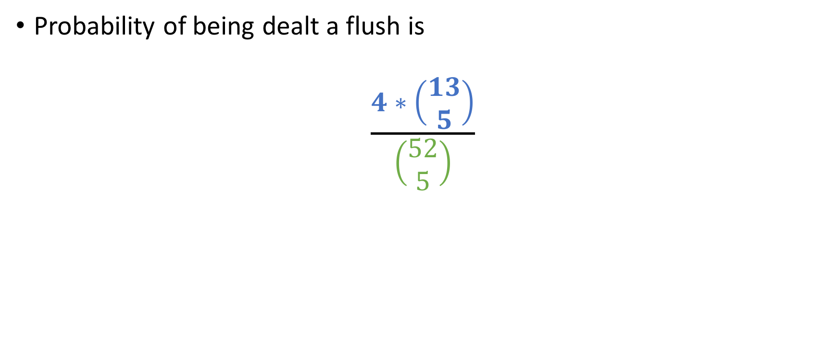
Probability of a flush
Probability of being dealt a flush is
$$\frac{4∗\left(\begin{aligned}13 \\ 5\end{aligned}\right)}{\left(\begin{aligned}52 \\ 5\end{aligned}\right)}$$

Slide 22
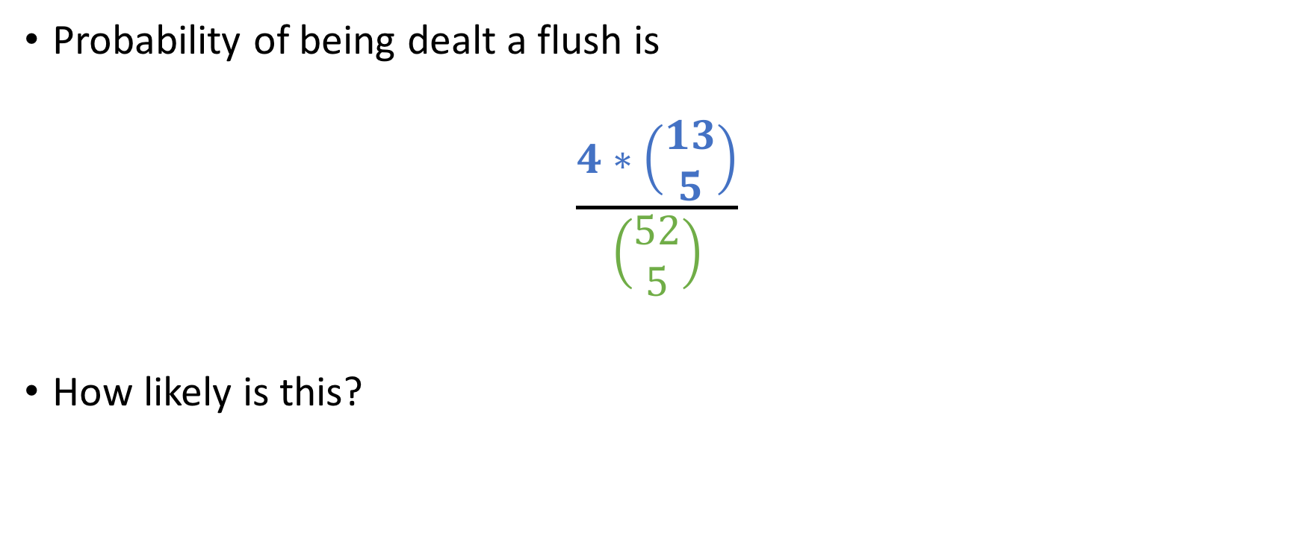
Probability of a flush
Probability of being dealt a flush is
$$\frac{4∗\left(\begin{aligned}13 \\ 5\end{aligned}\right)}{\left(\begin{aligned}52 \\ 5\end{aligned}\right)}$$
How likely is this?

Slide 23
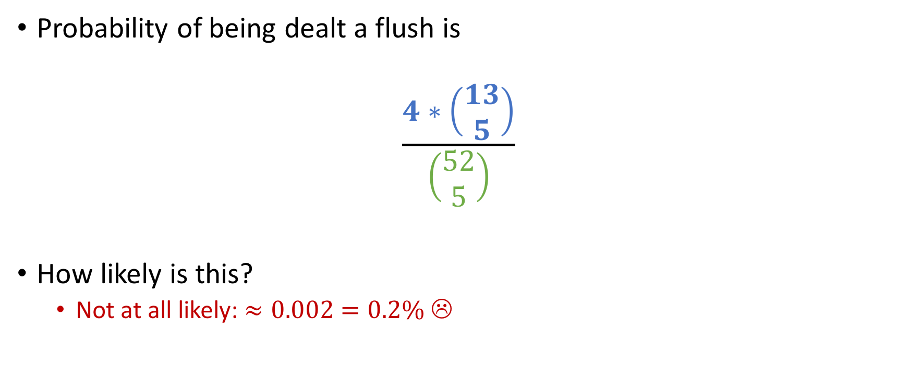
Probability of a flush
Probability of being dealt a flush is
$$\frac{4∗\left(\begin{aligned}13 \\ 5\end{aligned}\right)}{\left(\begin{aligned}52 \\ 5\end{aligned}\right)}$$
How likely is this?
Not at all likely: $≈0.002=0.2\%$ ☹

Slide 24
Likelihood of a straight
Straights are 5 cards of consecutive rank
Ace can be either end (high or low)
No wrap-arounds (e.g Q K A 2 3, suits don’t matter)
What is the probability that we are dealt a straight?

Slide 25
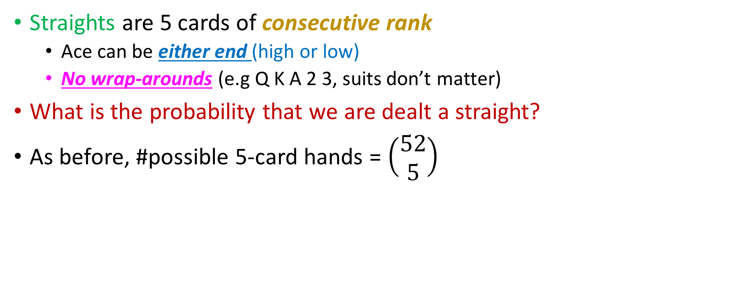
Likelihood of a straight
Straights are 5 cards of consecutive rank
Ace can be either end (high or low)
No wrap-arounds (e.g Q K A 2 3, suits don’t matter)
What is the probability that we are dealt a straight?
As before, #possible 5-card hands = $\left(\begin{aligned}52 \\ 5\end{aligned}\right)$

Slide 26
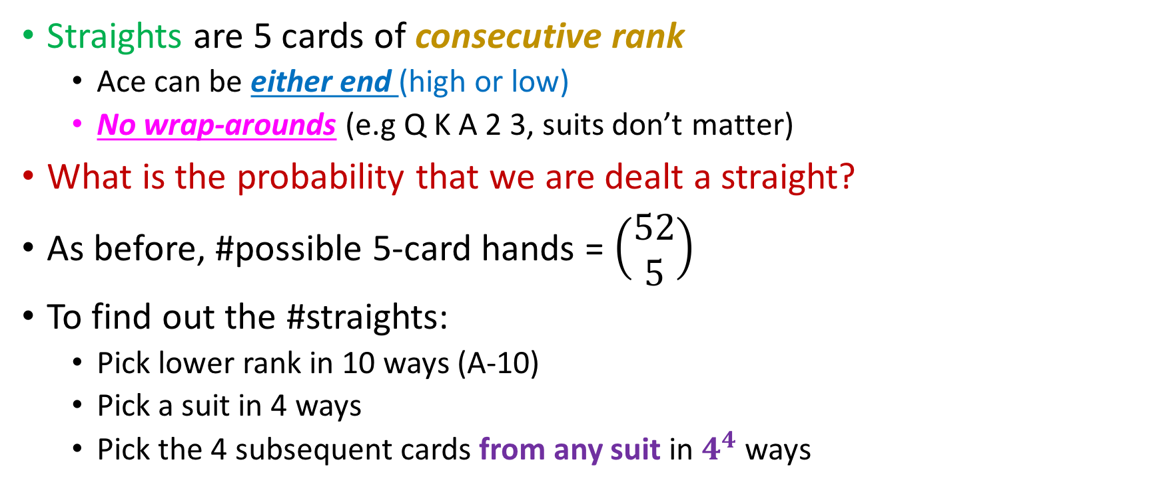
Likelihood of a straight
Straights are 5 cards of consecutive rank
Ace can be either end (high or low)
No wrap-arounds (e.g Q K A 2 3, suits don’t matter)
What is the probability that we are dealt a straight?
As before, #possible 5-card hands = $\left(\begin{aligned}52 \\ 5\end{aligned}\right)$
To find out the #straights:
Pick lower rank in 10 ways (A-10)
Pick a suit in 4 ways
Pick the 4 subsequent cards from any suit in $4^{4}$ ways

Slide 27
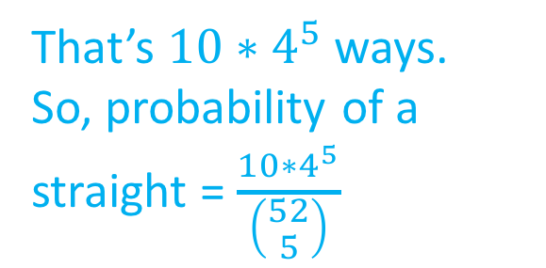
Likelihood of a straight
Straights are 5 cards of consecutive rank
Ace can be either end (high or low)
No wrap-arounds (e.g Q K A 2 3, suits don’t matter)
What is the probability that we are dealt a straight?
As before, #possible 5-card hands = $\left(\begin{aligned}52 \\ 5\end{aligned}\right)$
To find out the #straights:
Pick lower rank in 10 ways (A-10)
Pick a suit in 4 ways
Pick the 4 subsequent cards from any suit in $4^{4}$ ways
That’s $10∗4^{5}$ ways.
So, probability of a straight = $\frac{10∗4^{5}}{\left(\begin{aligned}52 \\ 5\end{aligned}\right)}$

Slide 28
Caveat on flushes
Wikipedia says we’re wrong about flushes!
Formally, our flushes included (for example) 3h 4h 5h 6h 7h
Hands like these are called straight flushes and Wikipedia does not include them.

Slide 29
Caveat on flushes
Wikipedia says we’re wrong about flushes!
Formally, our flushes included (for example) 3h 4h 5h 6h 7h
Hands like these are called straight flushes and Wikipedia does not include them.
How many straight flushes are there?

Slide 30
Caveat on flushes
Wikipedia says we’re wrong about flushes!
Formally, our flushes included (for example) 3h 4h 5h 6h 7h
Hands like these are called straight flushes and Wikipedia does not include them.
How many straight flushes are there?
40. Here’s why:
Pick rank: A through 10 (higher ranks don’t allow straights) in 10 ways
Pick suit in 4 ways

Slide 31
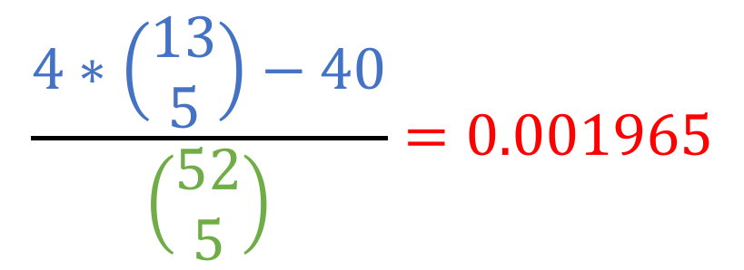
Probability of non-straight flush…
$$\frac{4∗\left(\begin{aligned}13 \\ 5\end{aligned}\right)−40}{\left(\begin{aligned}52 \\ 5\end{aligned}\right)}=0.001965$$
This is how Wikipedia defines the probability of a flush. ☺

Slide 32
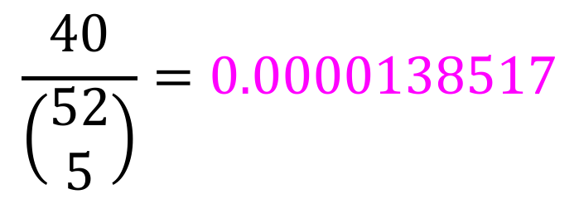
Probability of a straight flush…
$$\frac{40}{\left(\begin{aligned}52 \\ 5\end{aligned}\right)}=0.0000138517$$

Slide 33
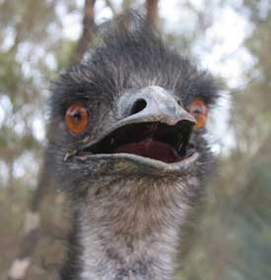

Probability of a straight flush…
$$\frac{40}{\left(\begin{aligned}52 \\ 5\end{aligned}\right)}=0.0000138517$$
The expected # hands you need to play to get a straight flush is then
$$⌈\frac{1}{0.0000138517 }⌉=72,194$$

Slide 34
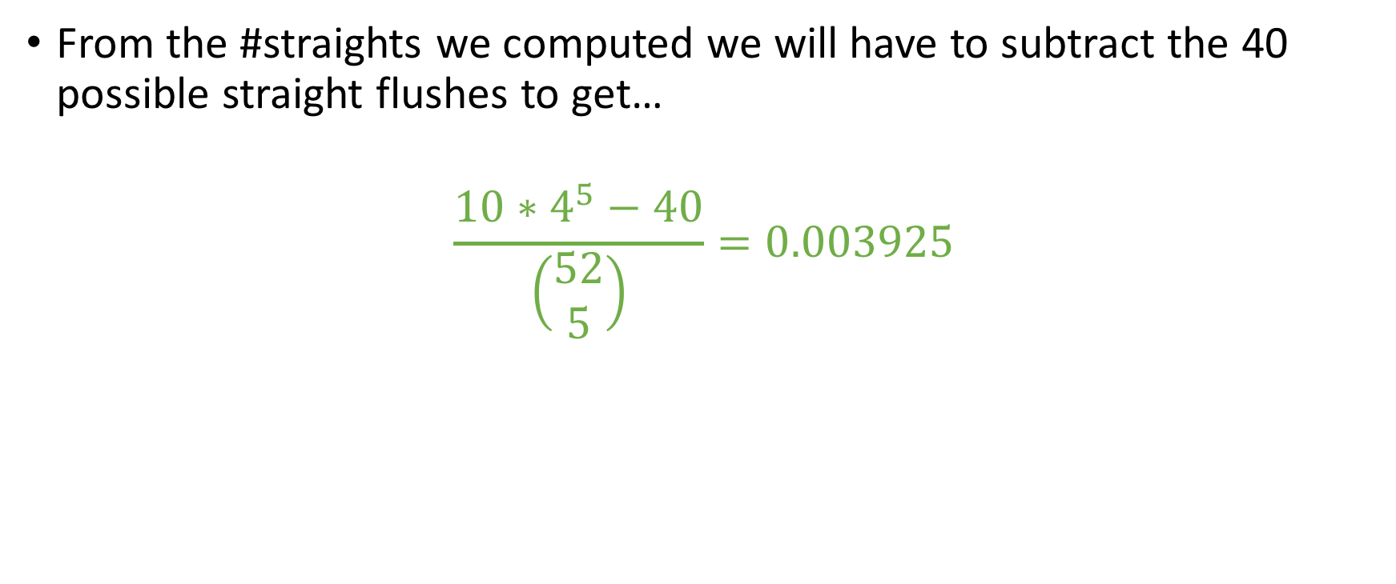
Same caveat for straights
From the #straights we computed we will have to subtract the 40 possible straight flushes to get…
$$\frac{10∗4^{5}−40}{\left(\begin{aligned}52 \\ 5\end{aligned}\right)}=0.003925$$

Slide 35
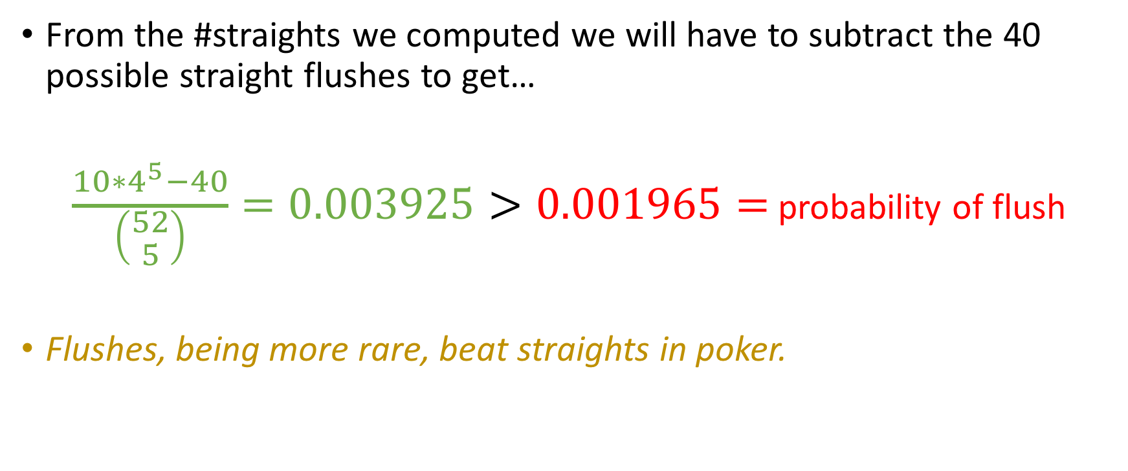
Same caveat
From the #straights we computed we will have to subtract the 40 possible straight flushes to get…
$\frac{10∗4^{5}−40}{\left(\begin{aligned}52 \\ 5\end{aligned}\right)}=0.003925>0.001965=$ probability of flush
Flushes, being more rare, beat straights in poker.

Slide 36

$$\text{Probability} \text{of} \text{a} \text{pair}$$
Try to calculate the probability of a pair!

Slide 37
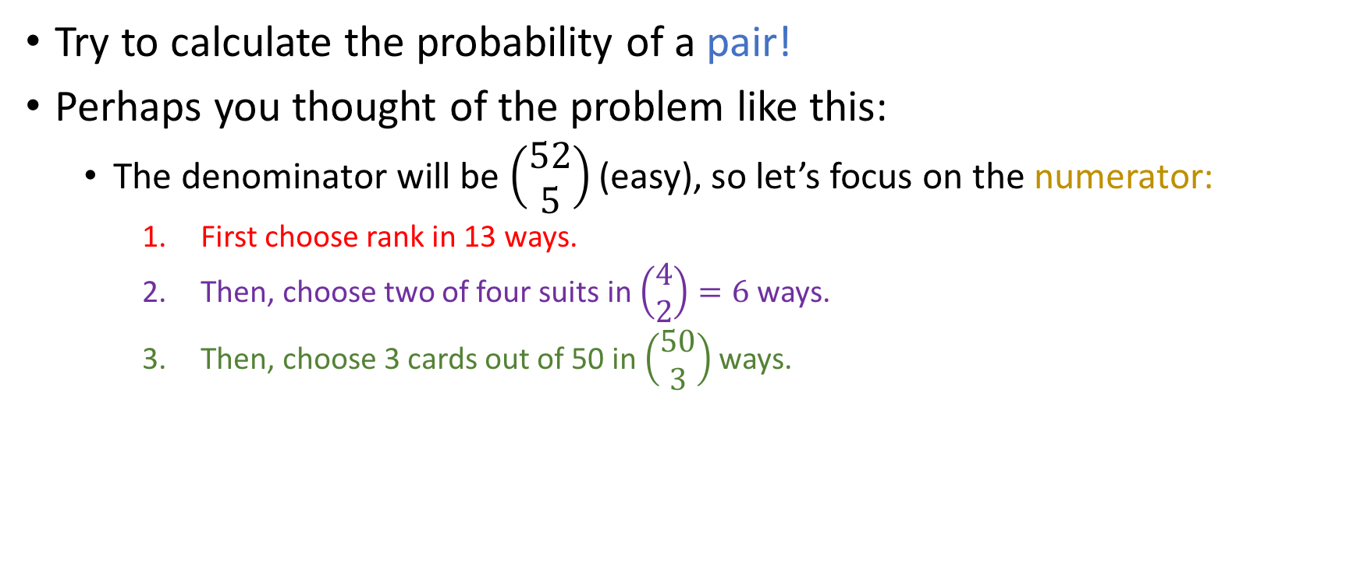
$$\text{Probability} \text{of} \text{a} \text{pair}$$
Try to calculate the probability of a pair!
Perhaps you thought of the problem like this:
The denominator will be $\left(\begin{aligned}52 \\ 5\end{aligned}\right)$ (easy), so let’s focus on the numerator:
First choose rank in 13 ways.
Then, choose two of four suits in $\left(\begin{aligned}4 \\ 2\end{aligned}\right)=6$ ways.
Then, choose 3 cards out of 50 in $\left(\begin{aligned}50 \\ 3\end{aligned}\right)$ ways.

Slide 38
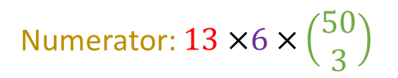
$$\text{Probability} \text{of} \text{a} \text{pair}$$
Try to calculate the probability of a pair!
Perhaps you thought of the problem like this:
The denominator will be $\left(\begin{aligned}52 \\ 5\end{aligned}\right)$ (easy), so let’s focus on the numerator:
First choose rank in 13 ways.
Then, choose two of four suits in $\left(\begin{aligned}4 \\ 2\end{aligned}\right)=6$ ways.
Then, choose 3 cards out of 50 in $\left(\begin{aligned}50 \\ 3\end{aligned}\right)$ ways.
Numerator: $13 ×6 ×\left(\begin{aligned}50 \\ 3\end{aligned}\right)$

Slide 39
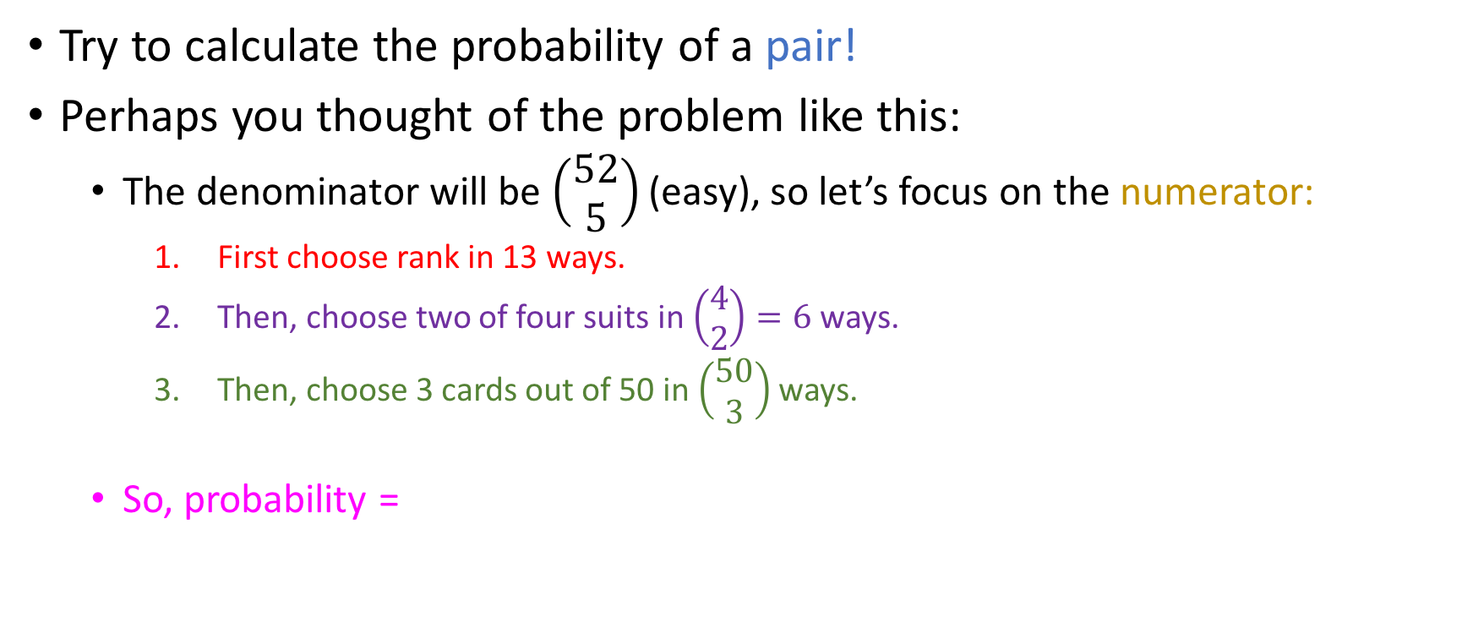
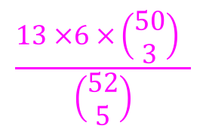
$$\text{Probability} \text{of} \text{a} \text{pair}$$
Try to calculate the probability of a pair!
Perhaps you thought of the problem like this:
The denominator will be $\left(\begin{aligned}52 \\ 5\end{aligned}\right)$ (easy), so let’s focus on the numerator:
First choose rank in 13 ways.
Then, choose two of four suits in $\left(\begin{aligned}4 \\ 2\end{aligned}\right)=6$ ways.
Then, choose 3 cards out of 50 in $\left(\begin{aligned}50 \\ 3\end{aligned}\right)$ ways.
So, probability =
Numerator: $13 ×6 ×\left(\begin{aligned}50 \\ 3\end{aligned}\right)$
$$\frac{13 ×6 ×\left(\begin{aligned}50 \\ 3\end{aligned}\right) }{\left(\begin{aligned}52 \\ 5\end{aligned}\right)}$$

Slide 40

$$\text{Probability} \text{of} \text{a} \text{pair}$$
Try to calculate the probability of a pair!
Perhaps you thought of the problem like this:
The denominator will be $\left(\begin{aligned}52 \\ 5\end{aligned}\right)$ (easy), so let’s focus on the numerator:
First choose rank in 13 ways.
Then, choose two of four suits in $\left(\begin{aligned}4 \\ 2\end{aligned}\right)=6$ ways.
Then, choose 3 cards out of 50 in $\left(\begin{aligned}50 \\ 3\end{aligned}\right)$ ways.
So, probability =
Numerator: $13 ×6 ×\left(\begin{aligned}50 \\ 3\end{aligned}\right)$
$$\frac{13 ×6 ×\left(\begin{aligned}50 \\ 3\end{aligned}\right) }{\left(\begin{aligned}52 \\ 5\end{aligned}\right)}$$
Is this accurate?
Yes
No

Slide 41

$$\text{Probability} \text{of} \text{a} \text{pair}$$
Try to calculate the probability of a pair!
Perhaps you thought of the problem like this:
The denominator will be $\left(\begin{aligned}52 \\ 5\end{aligned}\right)$ (easy), so let’s focus on the numerator:
First choose rank in 13 ways.
Then, choose two of four suits in $\left(\begin{aligned}4 \\ 2\end{aligned}\right)=6$ ways.
Then, choose 3 cards out of 50 in $\left(\begin{aligned}50 \\ 3\end{aligned}\right)$ ways.
So, probability =
Numerator: $13 ×6 ×\left(\begin{aligned}50 \\ 3\end{aligned}\right)$
$$\frac{13 ×6 ×\left(\begin{aligned}50 \\ 3\end{aligned}\right) }{\left(\begin{aligned}52 \\ 5\end{aligned}\right)}$$
Severe overcount!
Is this accurate?
Yes
No

Slide 42
Don’t count better hands!
In the computation before, we included:
3-of-a-kind
4-of-a-kind
etc
To properly compute, we would have to subtract all better hands possible with at least one pair.

Slide 43
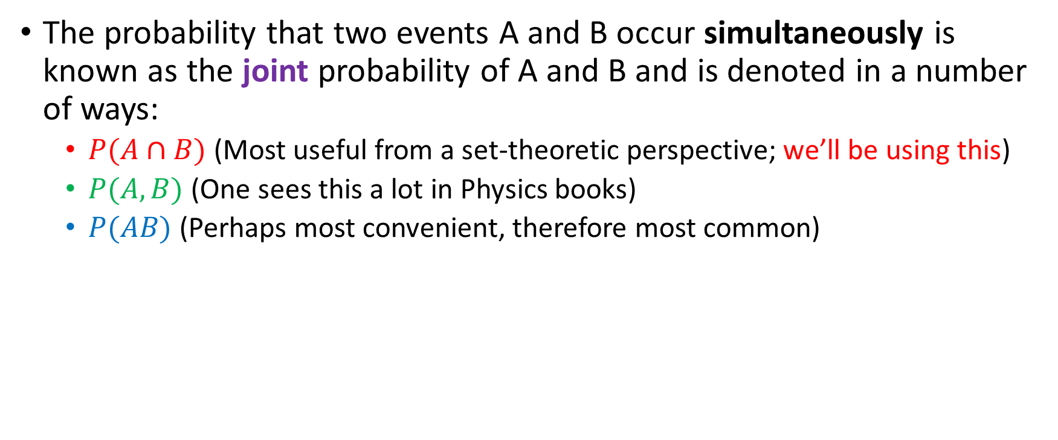
Joint probability (“AND” of two events)
The probability that two events A and B occur simultaneously is known as the joint probability of A and B and is denoted in a number of ways:
$P(A∩B)$ (Most useful from a set-theoretic perspective; we’ll be using this)
$P(A,B)$ (One sees this a lot in Physics books)
$P(AB)$ (Perhaps most convenient, therefore most common)

Slide 44
Calculating joints
Probability that the first coin toss is heads and the second coin toss is tails

Slide 45
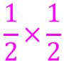
Calculating joints
$$\frac{1}{2}×\frac{1}{2}$$
Probability that the first coin toss is heads and the second coin toss is tails

Slide 46
Calculating joints
$$\frac{1}{2}×\frac{1}{2}$$
Probability that the first coin toss is heads and the second coin toss is tails
Probability that the first die is at most a 2 and the second one is 5 or 6

Slide 47
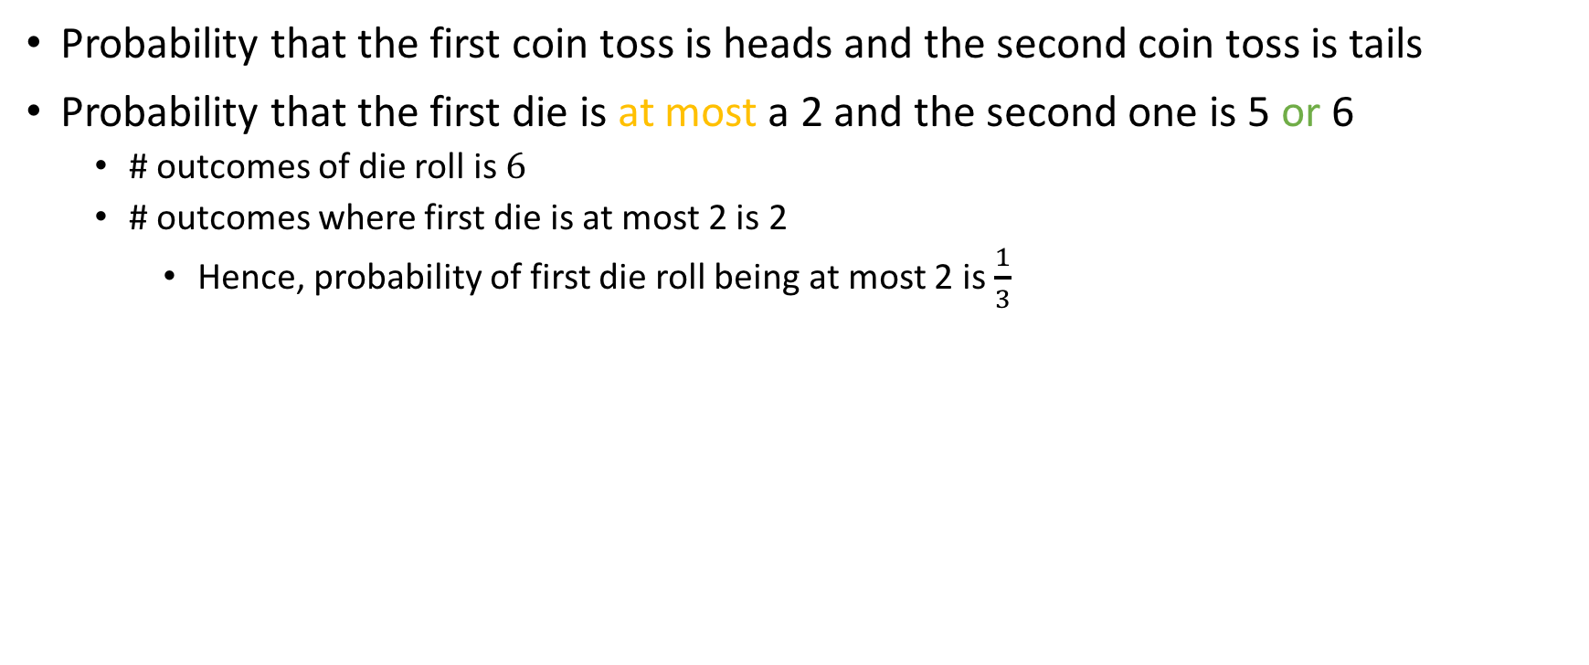
Calculating joints
$$\frac{1}{2}×\frac{1}{2}$$
Probability that the first coin toss is heads and the second coin toss is tails
Probability that the first die is at most a 2 and the second one is 5 or 6
# outcomes of die roll is $6$
# outcomes where first die is at most 2 is 2
Hence, probability of first die roll being at most 2 is $\frac{1}{3}$

Slide 48
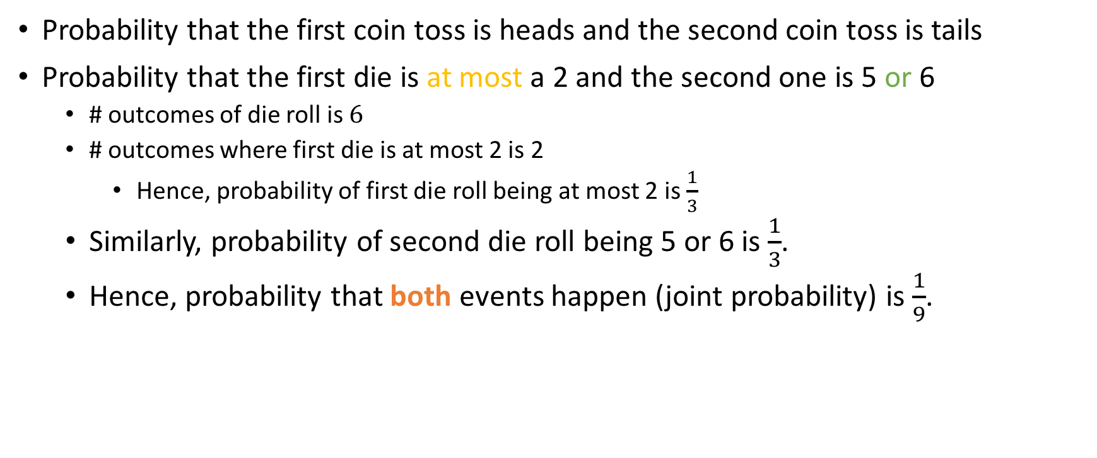
Calculating joints
$$\frac{1}{2}×\frac{1}{2}$$
Probability that the first coin toss is heads and the second coin toss is tails
Probability that the first die is at most a 2 and the second one is 5 or 6
# outcomes of die roll is $6$
# outcomes where first die is at most 2 is 2
Hence, probability of first die roll being at most 2 is $\frac{1}{3}$
Similarly, probability of second die roll being 5 or 6 is $\frac{1}{3}$.
Hence, probability that both events happen (joint probability) is $\frac{1}{9}$.

Slide 49
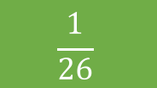
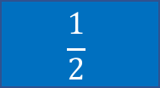

Calculating joints
Jason’s going to flip a coin and then pick a card from a 52-card deck.
Probability that the coin is heads and the card has rank 8?
$$\frac{1}{2}$$
$$\frac{1}{26}$$
$$\frac{1}{32}$$
Something else

Slide 50
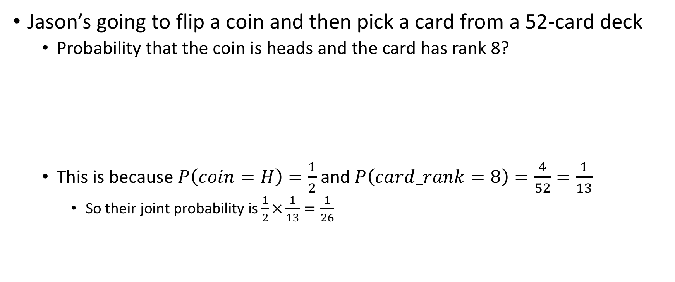
Calculating joints
Jason’s going to flip a coin and then pick a card from a 52-card deck
Probability that the coin is heads and the card has rank 8?
This is because $P\left(coin=H\right)=\frac{1}{2}$ and $P\left(card_rank=8\right)=\frac{4}{52}=\frac{1}{13}$
So their joint probability is $\frac{1}{2}×\frac{1}{13}=\frac{1}{26}$
$$\frac{1}{2}$$
$$\frac{1}{26}$$
$$\frac{1}{32}$$
Something else

Slide 51
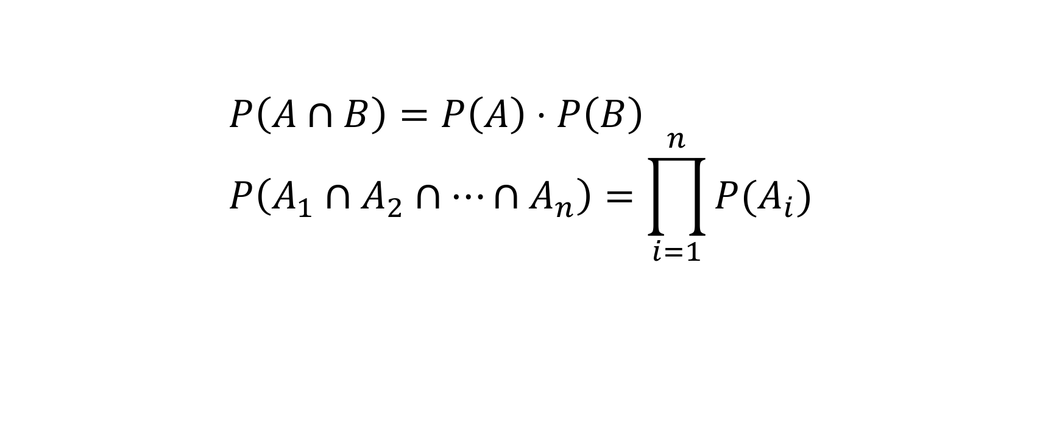
The law of joint probability
$$P\left(A∩B\right)=P\left(A\right)⋅P\left(B\right) \\ P\left(A_{1}∩A_{2}∩…∩A_{n}\right)=\prod_{i=1}^{n}{P(A_{i})}$$

Slide 52
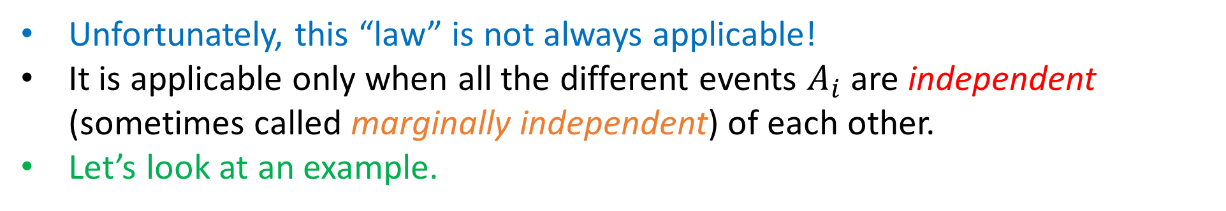
The law of joint probability
$$P\left(A∩B\right)=P\left(A\right)⋅P\left(B\right) \\ P\left(A_{1}∩A_{2}∩…∩A_{n}\right)=\prod_{i=1}^{n}{P(A_{i})}$$
Unfortunately, this “law” is not always applicable!
It is applicable only when all the different events $A_{i}$ are independent (sometimes called marginally independent) of each other.
Let’s look at an example.

Slide 53
What if the events influence each other?
Probability that a die is even and that it is 2.

Slide 54
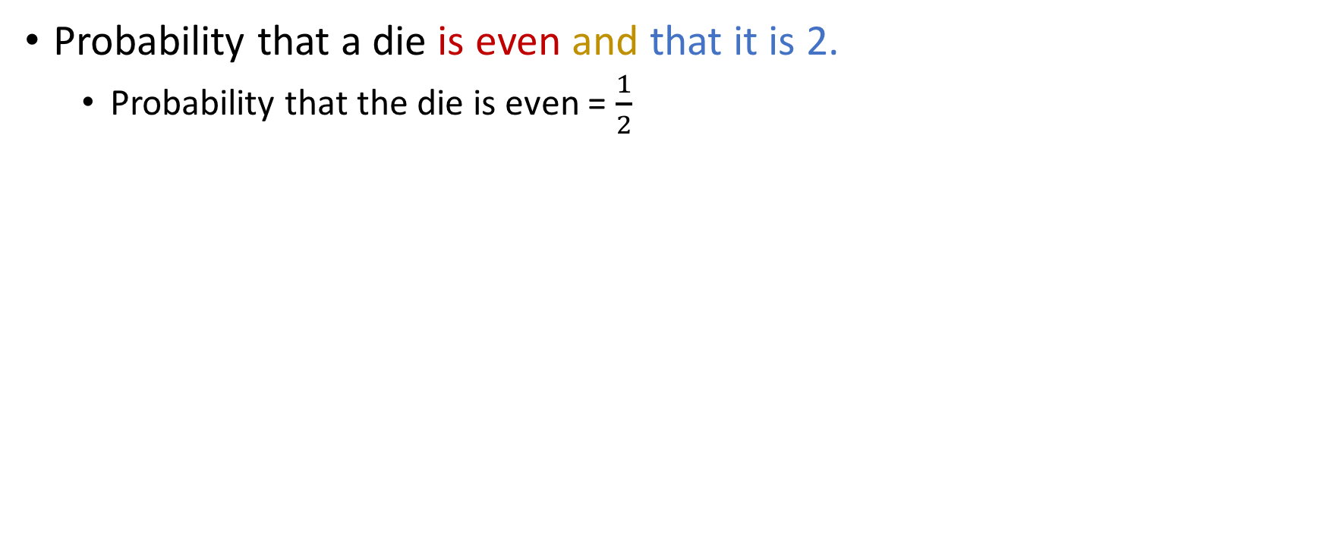
What if the events influence each other?
Probability that a die is even and that it is 2.
Probability that the die is even = $\frac{1}{2}$

Slide 55
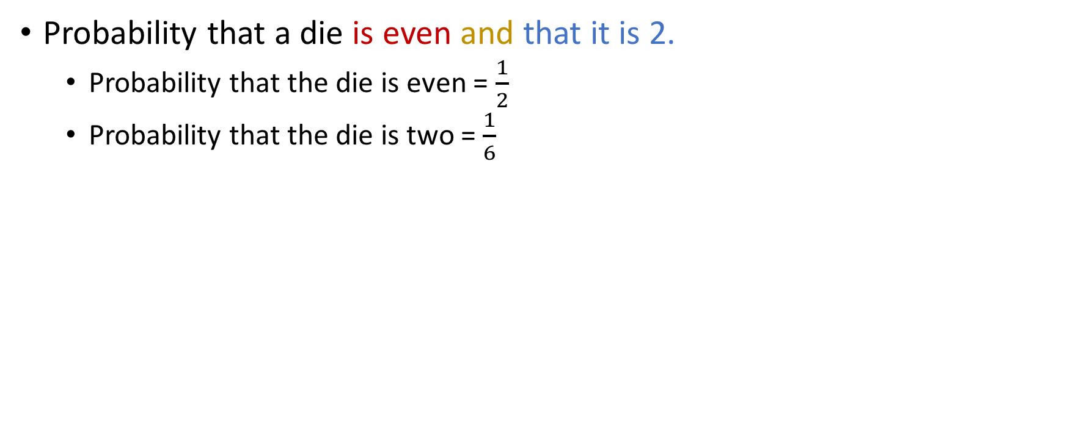
What if the events influence each other?
Probability that a die is even and that it is 2.
Probability that the die is even = $\frac{1}{2}$
Probability that the die is two = $\frac{1}{6}$

Slide 56

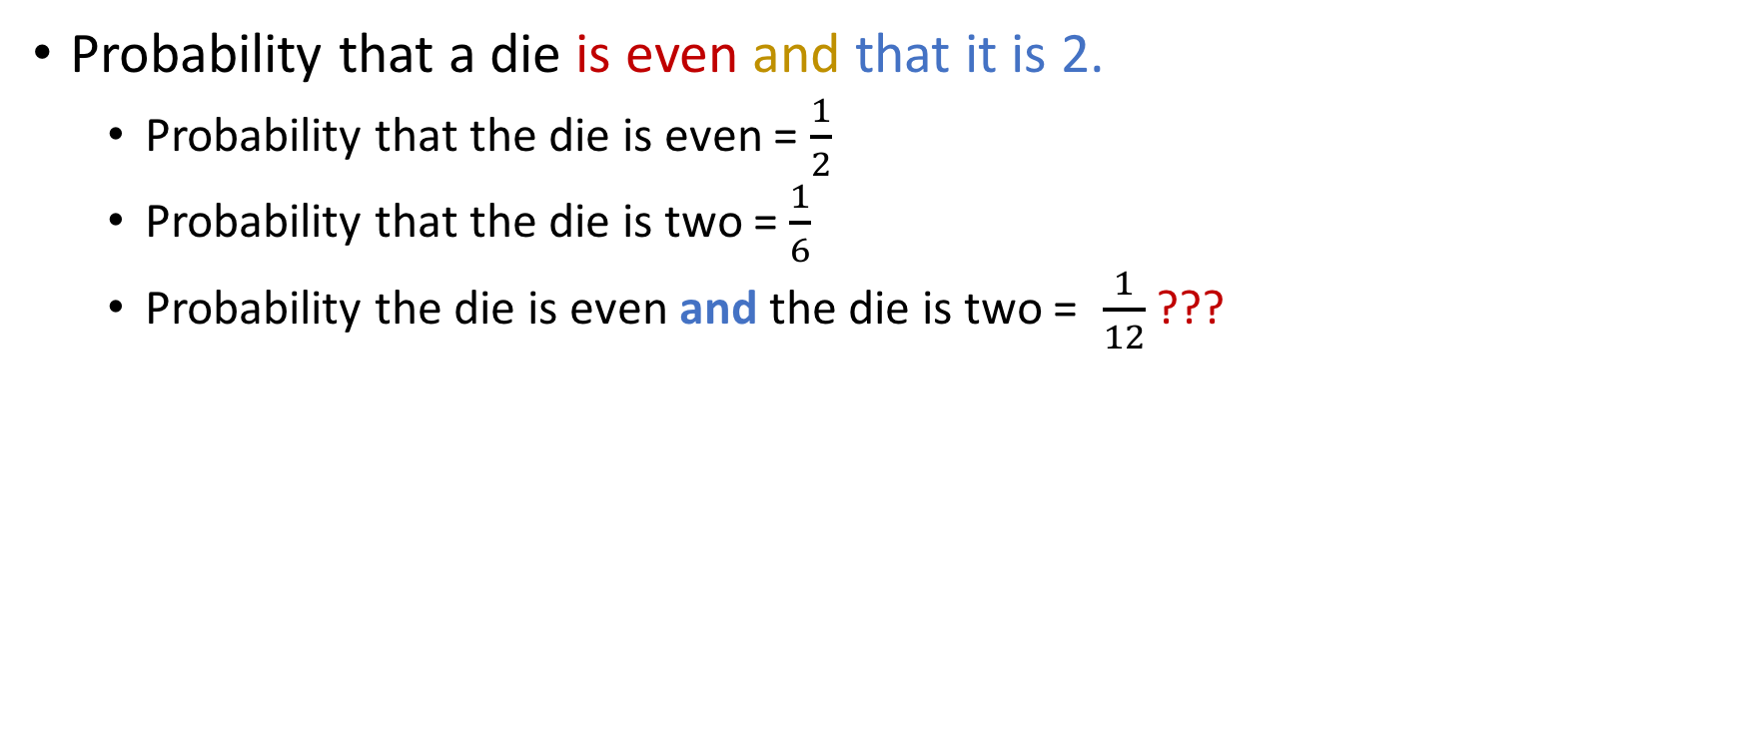
What if the events influence each other?
Probability that a die is even and that it is 2.
Probability that the die is even = $\frac{1}{2}$
Probability that the die is two = $\frac{1}{6}$
Probability the die is even and the die is two = $\frac{1}{12}$ ???

Slide 57
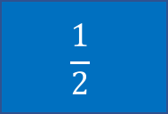
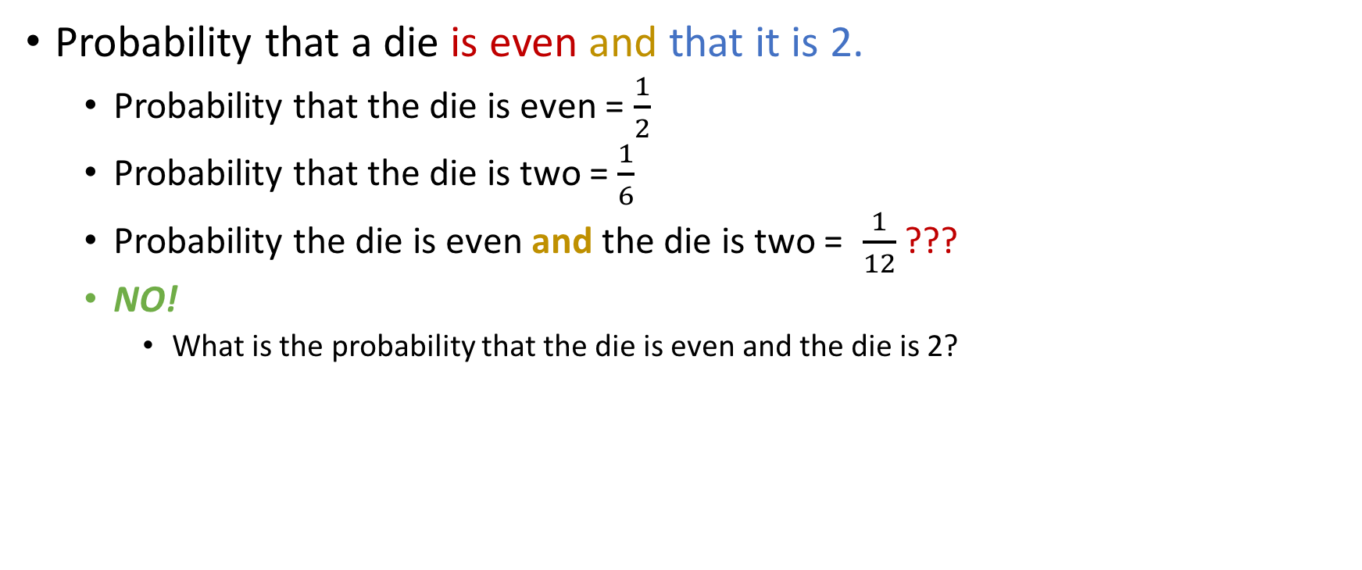



What if the events influence each other?
Probability that a die is even and that it is 2.
Probability that the die is even = $\frac{1}{2}$
Probability that the die is two = $\frac{1}{6}$
Probability the die is even and the die is two = $\frac{1}{12}$ ???
NO!
What is the probability that the die is even and the die is 2?
$$\frac{1}{2}$$
$$\frac{1}{4}$$
$$\frac{1}{5}$$
$$\frac{1}{6}$$

Slide 58

What if the events influence each other?
Probability that a die is even and that it is 2.
Probability that the die is even = $\frac{1}{2}$
Probability that the die is two = $\frac{1}{6}$
Probability the die is even and the die is two = $\frac{1}{12}$ ???
NO!
What is the probability that the die is even and the die is 2?
$$\frac{1}{2}$$
$$\frac{1}{4}$$
$$\frac{1}{5}$$
$$\frac{1}{6}$$

Slide 59

Set-theoretic interpretation
Notice that the event A: “Die roll is even” is a superset of the event B: “Die roll comes 2”
Since $A∩B=A, P\left(A∩B\right)=P\left(A\right)=\frac{1}{6}$
3
6
1
4
2
Die roll even
Die roll comes 2
5

Slide 60
Calculating joints
The University of Southern North Dakota offers a Discrete Mathematics Course where the possible grades are A through G. (No + or -)
What is the probability that Jason gets both an A and a G in that course?

Slide 61

Calculating joints
The University of Southern North Dakota offers a Discrete Mathematics Course where the possible grades are A through G. (No + or -)
What is the probability that Jason gets both an A and a G in that course?
Clearly, it can’t be
$$\text{(}\text{probability} \text{Jason} \text{gets} \text{an} \text{A}\text{) }\text{X}\text{ (}\text{probability} \text{Jason} \text{gets} \text{a} \text{B}\text{) = }\frac{1}{7}×\frac{1}{7}=\frac{1}{49}$$

Slide 62
Calculating joints
The University of Southern North Dakota offers a Discrete Mathematics Course where the possible grades are A through G. (No + or -)
What is the probability that Jason gets both an A and a G in that course?
Clearly, it can’t be
$$\text{(}\text{probability} \text{Jason} \text{gets} \text{an} \text{A}\text{) }\text{X}\text{ (}\text{probability} \text{Jason} \text{gets} \text{a} \text{B}\text{) = }\frac{1}{7}×\frac{1}{7}=\frac{1}{49}$$

Slide 63

Calculating joints
The University of Southern North Dakota offers a Discrete Mathematics Course where the possible grades are A through G. (No + or -)
What is the probability that Jason gets both an A and a G in that course?
Clearly, it can’t be
$$\text{(}\text{probability} \text{Jason} \text{gets} \text{an} \text{A}\text{) }\text{X}\text{ (}\text{probability} \text{Jason} \text{gets} \text{a} \text{B}\text{) = }\frac{1}{7}×\frac{1}{7}=\frac{1}{49}$$
It is 0. Those two events cannot happen jointly!

Slide 64

Calculating joints
The University of Southern North Dakota offers a Discrete Mathematics Course where the possible grades are A through G. (No + or -)
What is the probability that Jason gets both an A and a G in that course?
Clearly, it can’t be
$$\text{(}\text{probability} \text{Jason} \text{gets} \text{an} \text{A}\text{) }\text{X}\text{ (}\text{probability} \text{Jason} \text{gets} \text{a} \text{B}\text{) = }\frac{1}{7}×\frac{1}{7}=\frac{1}{49}$$
It is 0. Those two events cannot happen jointly!
Events such as these are called disjoint or mutually disjoint.

Slide 65

Set-theoretic interpretation
A = “Jason gets an A in USND’s 250”
G=“Jason gets a G in USND’s 250”
Note that $A∩G=∅,$so there are no common outcomes.
So $P(A∩G)=0$
A
G

Slide 66

Calculating joints
I have my original die again.
Probability that it comes up 1, 2 or 3 = $\frac{1}{2}$
Probability that it comes up 3, 4 or 5 = $\frac{1}{2}$
What is the probability that it comes up 1, 2 or 3 and 3, 4 or 5?

Slide 67




Calculating joints
I have my original die again.
Probability that it comes up 1, 2 or 3 = $\frac{1}{2}$
Probability that it comes up 3, 4 or 5 = $\frac{1}{2}$
What is the probability that it comes up 1, 2 or 3 and 3, 4 or 5?
$$\frac{1}{6}$$
$$\frac{1}{5}$$
$$\frac{1}{4}$$
$$\frac{1}{3}$$

Slide 68

Calculating joints
I have my original die again.
Probability that it comes up 1, 2 or 3 = $\frac{1}{2}$
Probability that it comes up 3, 4 or 5 = $\frac{1}{2}$
What is the probability that it comes up 1, 2 or 3 and 3, 4 or 5?
Note that the only common outcome between the two events is 3, which can come up only once out of six possibilities.
$$\frac{1}{6}$$
$$\frac{1}{5}$$
$$\frac{1}{4}$$
$$\frac{1}{3}$$

Slide 69
Set-theoretic interpretation
Let A = dice comes up 1, 2, or 3
Let B = dice comes up 3, 4, or 5
Let C = dice comes up 1, 2, 3, 4, 5 OR 6
A
B
4
1
3
5
6
2
C

Slide 70

Set-theoretic interpretation
Let A = dice comes up 1, 2, or 3
Let B = dice comes up 3, 4, or 5
Let C = dice comes up 1, 2, 3, 4, 5 OR 6
Then, probability that the dice comes up 3 = $\frac{1}{6}$
A
B
4
1
3
5
6
2
C

Slide 71
Independent events (informally)
Two events are independent if one does not influence the other.
Examples:
The event E1 = “first coin toss” and E2 = “second coin toss”
With the same die, the events E1 = “roll 1”, E2 = “roll 2”, E3 = “roll 3”
Jason flips a coin and then picks a card.
Counter-examples:
E1 = “Die is even”, E2=“Die is 6”
E1= “Grade in 250” and “Passing 250”

Slide 72

Law of joint probability (informally)
Two events are independent if one does not influence the other.
This definition is a but too informal, so mathematicians tend to avoid it.
Formally, we define that $A$ and $B$ are independent if
$$P\left(A∩B\right)=P\left(A\right)⋅P(B)$$

Slide 73

Disjoint or independent?
$E_{1}=$ “It rains in College Park, MD today”
$E_{2}=$ “It rains in Athens, Greece today”
Disjoint
Independent
Both
Neither

Slide 74

Disjoint or independent?
Weather is weird!
$E_{1}=$ “It rains in College Park, MD today”
$E_{2}=$ “It rains in Athens, Greece today”
Disjoint
Independent
Both
Neither

Slide 75

Disjoint or independent?
Weather is weird!
$E_{1}=$ “It rains in College Park, MD today”
$E_{2}=$ “It rains in Athens, Greece today”
$E_{1}=$ “It rains in College Park, MD today”
$E_{2}=$ “It is sunny in College Park, MD today”
Disjoint
Independent
Both
Neither
Disjoint
Independent
Both
Neither

Slide 76

Disjoint or independent?
Weather is weird!
$E_{1}=$ “It rains in College Park, MD today”
$E_{2}=$ “It rains in Athens, Greece today”
$E_{1}=$ “It rains in College Park, MD today”
$E_{2}=$ “It is sunny in College Park, MD today”
Disjoint
Independent
Both
Neither
Disjoint
Independent
Both
Neither

Slide 77

Disjoint or independent?
Weather is weird!
$E_{1}=$ “It rains in College Park, MD today”
$E_{2}=$ “It rains in Athens, Greece today”
$E_{1}=$ “It rains in College Park, MD today”
$E_{2}=$ “It is sunny in College Park, MD today”
$E_{1}=$ Die #1 comes at most 4
$E_{2}$= Die #2 comes at least 5
Disjoint
Independent
Both
Neither
Disjoint
Independent
Both
Neither
Disjoint
Independent
Both
Neither

Slide 78

Disjoint or independent?
Weather is weird!
$E_{1}=$ “It rains in College Park, MD today”
$E_{2}=$ “It rains in Athens, Greece today”
$E_{1}=$ “It rains in College Park, MD today”
$E_{2}=$ “It is sunny in College Park, MD today”
$E_{1}=$ Die #1 comes at most 4
$E_{2}$= Die #2 comes at least 5
Disjoint
Independent
Both
Neither
Disjoint
Independent
Both
Neither
Disjoint
Independent
Both
Neither

Slide 79

Disjoint or independent?
Weather is weird!
$E_{1}=$ “It rains in College Park, MD today”
$E_{2}=$ “It rains in Athens, Greece today”
$E_{1}=$ “It rains in College Park, MD today”
$E_{2}=$ “It is sunny in College Park, MD today”
$E_{1}=$ Die #1 comes at most 4
$E_{2}$= Die #2 comes at least 5
$E_{1}=$ Student gets a C
$E_{2}=$ Student passes the class
Disjoint
Independent
Both
Neither
Disjoint
Independent
Both
Neither
Disjoint
Independent
Both
Neither
Disjoint
Independent
Both
Neither

Slide 80

Disjoint or independent?
Weather is weird!
$E_{1}=$ “It rains in College Park, MD today”
$E_{2}=$ “It rains in Athens, Greece today”
$E_{1}=$ “It rains in College Park, MD today”
$E_{2}=$ “It is sunny in College Park, MD today”
$E_{1}=$ Die #1 comes at most 4
$E_{2}$= Die #2 comes at least 5
$E_{1}=$ Student gets a C
$E_{2}=$ Student passes the class
Disjoint
Independent
Both
Neither
Disjoint
Independent
Both
Neither
Disjoint
Independent
Both
Neither
Disjoint
Independent
Both
Neither

Slide 81

Recap: “Disjoint” vs “independent”
Friends don’t let friends get confused between “disjoint” and “independent”!
Disjoint | Independent
Has a set-theoretic interpretation! | Has a causality interpretation!
Means that $P\left(A∩B\right)=0$ | Means that $P\left(A∩B\right)=P\left(A\right)⋅P(B)$
Means that $P\left(A∪B\right)=P\left(A\right)+P(B)$ | Means that $P\left(A∪B\right)=P\left(A\right)+P\left(B\right)−P\left(A\right)⋅P(B)$

Slide 82
Disjoint Probability (“OR” of two events)
Jason rolls two dice.
What is the probability that he rolls a 7 or a 9?

Slide 83

Disjoint Probability (“OR” of two events)
Jason rolls two dice.
What is the probability that he rolls a 7 or a 9?
#Ways to roll a 7 is 6.
#Ways to roll a 9 is 4: (6, 3), (5, 4), (4, 5), (3, 6)
#Ways to roll a 7 OR a 9 is then 10.
Therefore, the probability is $\frac{10}{36}=\frac{5}{18}$
Key: Rolling a 7 and a 9 are disjoint events.

Slide 84
Disjoint probability (“OR”)
52-card deck
Probability of drawing a face card (J, Q, K) or a heart

Slide 85
Disjoint probability (“OR”)
52-card deck
Probability of drawing a face card (J, Q, K) or a heart
Are these disjoint?

Slide 86

Disjoint probability (“OR”)
52-card deck
Probability of drawing a face card (J, Q, K) or a heart
Are these disjoint?
NO, for example, Queen of hearts
How big is $Face_Card∪Hearts$?

Slide 87

Disjoint probability (“OR”)
52-card deck
Probability of drawing a face card (J, Q, K) or a heart
Are these disjoint?
NO, for example, Queen of hearts
How big is $Face_Card∪Hearts$ (abbrv. $F$, $H$ below)?
Use law of inclusion / exclusion!
$$\left|F∪H\right|=\left|F\right|+\left|H\right|−\left|F∩H\right|=12+13 −3=22$$

Slide 88

Disjoint probability (“OR”)
52-card deck
Probability of drawing a face card (J, Q, K) or a heart
Are these disjoint?
NO, for example, Queen of hearts
How big is $Face_Card∪Hearts$ (abbrv. $F$, $H$ below)?
Use law of inclusion / exclusion!
$$\left|F∪H\right|=\left|F\right|+\left|H\right|−\left|F∩H\right|=12+13 −3=22$$
So probability = $\frac{22}{52}=\frac{11}{26}$.

Slide 89

Alternative viewpoint
$P\left(F\right)=\frac{12}{52}$
$P\left(H\right)=\frac{13}{52}$
$P\left(F∩H\right)=\frac{3}{52}$
$P\left(F∪H\right)=P\left(F\right)+P\left(H\right)−P(F∩H)$

Slide 90

Probability of unions
$$P\left(A∪B\right)=P\left(A\right)+P\left(B\right)−P \left(A∩B\right)$$
If A and B are independent, we have
$P\left(A∪B\right)=P\left(A\right)+P\left(B\right)−P \left(A)⋅P(B\right)$
If A and B are disjoint, we have
$P\left(A∪B\right)=P\left(A\right)+P\left(B\right)$

Slide 91

Probability of unions of 3 sets
$P\left(A∪B∪C\right)=$ $P\left(A\right)+P\left(B\right)+P\left(C\right)$
$− P \left(A∩B\right)−P\left(B∩C\right)−P\left(A∩C\right)$ $+P(A∩B∩C)$
If A, B and C are pairwise independent , we have :
$P\left(A∪B∪C\right)=$ $P\left(A\right)+P\left(B\right)+P\left(C\right)−P\left(A\right)⋅P\left(B\right)−P\left(B\right)⋅P\left(C\right)−P\left(A\right)⋅P\left(C\right)+P\left(A⋅B⋅C\right)$
If A, B and C are pairwise disjoint (so $A∩B=A∩C=B∩C=∅$, so clearly $A∩B∩C=∅$), we have
$P\left(A∪B∪C\right)=$ $P\left(A\right)+P\left(B\right)+P\left(C\right)$

Slide 92
Conditional Probability
If A occurs, then is B
More likely?
Equally likely?
Less likely?

Slide 93
Conditional Probability
If A occurs, then is B
More likely?
Equally likely?
Less likely?
Any of these could happen, it depends on the relationship
between A and B.

Slide 94






Conditional Probability
If A occurs, then is B
More likely?
Equally likely?
Less likely?
Any of these could happen, it depends on the relationship
between A and B.
$$A$$
$$A$$
$$B$$
OR
$$A$$
$$B$$
OR
OR …
$$B$$

Slide 95

Examples
We roll two dice
Event A = “Sum of the dice $S≡0 (mod 4)”$
Note that $P\left(A\right)=\frac{9}{36}=\frac{1}{4}$, since we have nine rolls of the dice that sum to a multiple of 4:
(1, 3), (2, 2), (3, 1), (2, 6), (3, 5), (4, 4), (5, 3), (6, 2), (6, 6)
Event B = “The first die comes up 3”
Note that $P\left(B\right)=\frac{6}{36}=\frac{1}{6}$

Slide 96

Examples
We roll two dice
Event A = “Sum of the dice $S≡0 (mod 4)”$
Note that $P\left(A\right)=\frac{9}{36}=\frac{1}{4}$, since we have nine rolls of the dies that sum to a multiple of 4:
(1, 3), (2, 2), (3, 1), (2, 6), (3, 5), (4, 4), (5, 3), (6, 2), (6, 6)
Event B = “The first die comes up 3”
Note that $P\left(B\right)=\frac{6}{36}=\frac{1}{6}$
What is the probability of A given B?

Slide 97
Examples
What is the probability of A given B?

Slide 98
Examples
What is the probability of A given B?
Outcomes of A are (1, 3), (2, 2), (3, 1), (2, 6), (3, 5), (4, 4), (5, 3), (6, 2), (6, 6)
Outcomes of B are (3, 1), (3, 2), (3, 3), (3, 4), (3, 5), (3, 6)
Outcomes of rolling two dice: (1, 1), (1, 2), …., (6, 5), (6, 6)

Slide 99
Examples
What is the probability of A given B?
Outcomes of A are (1, 3), (2, 2), (3, 1), (2, 6), (3, 5), (4, 4), (5, 3), (6, 2), (6, 6)
Outcomes of B are (3, 1), (3, 2), (3, 3), (3, 4), (3, 5), (3, 6)
Outcomes of rolling two dice: (1, 1), (1, 2), …., (6, 5), (6, 6)

Slide 100

Examples
What is the probability of A given B?
Outcomes of A are (1, 3), (2, 2), (3, 1), (2, 6), (3, 5), (4, 4), (5, 3), (6, 2), (6, 6)
Outcomes of B are (3, 1), (3, 2), (3, 3), (3, 4), (3, 5), (3, 6)
Outcomes of rolling two dice: (1, 1), (1, 2), …., (6, 5), (6, 6)
As discussed, $P\left(A\right)=\frac{9}{36}=\frac{1}{4}$
However, once B occurs, instead of 36 outcomes, we now have…

Slide 101

Examples
What is the probability of A given B?
Outcomes of A are (1, 3), (2, 2), (3, 1), (2, 6), (3, 5), (4, 4), (5, 3), (6, 2), (6, 6)
Outcomes of B are (3, 1), (3, 2), (3, 3), (3, 4), (3, 5), (3, 6)
Outcomes of rolling two dice: (1, 1), (1, 2), …., (6, 5), (6, 6)
As discussed, $P\left(A\right)=\frac{9}{36}=\frac{1}{4}$
However, once B occurs, instead of 36 outcomes, we now have… 6 outcomes.

Slide 102

Examples
What is the probability of A given B?
Outcomes of A are (1, 3), (2, 2), (3, 1), (2, 6), (3, 5), (4, 4), (5, 3), (6, 2), (6, 6)
Outcomes of B are (3, 1), (3, 2), (3, 3), (3, 4), (3, 5), (3, 6)
Outcomes of rolling two dice: (1, 1), (1, 2), …., (6, 5), (6, 6)
As discussed, $P\left(A\right)=\frac{9}{36}=\frac{1}{4}$
However, once B occurs, instead of 36 outcomes, we now have… 6 outcomes.
Only 2 of them are outcomes that correspond to A.

Slide 103

Examples
What is the probability of A given B?
Outcomes of A are (1, 3), (2, 2), (3, 1), (2, 6), (3, 5), (4, 4), (5, 3), (6, 2), (6, 6)
Outcomes of B are (3, 1), (3, 2), (3, 3), (3, 4), (3, 5), (3, 6)
Outcomes of rolling two dice: (1, 1), (1, 2), …., (6, 5), (6, 6)
As discussed, $P\left(A\right)=\frac{9}{36}=\frac{1}{4}$
However, once B occurs, instead of 36 outcomes, we now have… 6 outcomes.
Only 2 of them are outcomes that correspond to A.
Therefore, the probability of A given B is $\frac{2}{6}=\frac{1}{3}$

Slide 104

Examples
We once again two roll dice
Event A = “Sum of the dice is $≥$ 8”
Event B = “ First die is 4”

Slide 105

Examples
We once again two roll dice
Event A = “Sum of the dice is $≥$ 8”
Event B = “ First die is 4”
If B happens, what is your intuition about the probability of A?

Slide 106
Examples
We once again two roll dice
Event A = “Sum of the dice is $≥$ 8”
Event B = “ First die is 4”
If B happens, what is your intuition about the probability of A?
Go up
Go down
Stay the same
Unknown to science

Slide 107
Examples
We once again two roll dice
Event A = “Sum of the dice is $≥$ 8”
Event B = “ First die is 4”
If B happens, what is your intuition about the probability of A?
Go up
Go down
Stay the same
Unknown to science
Let’s see if your intuition was correct!

Slide 108

Examples
We once again two roll dice
Event A = “Sum of the dice is $≥$ 8” $P\left(A\right)= ?$ (work on it)
Event B = “ First die is 4”

Slide 109

Examples
We once again two roll dice
Event A = “Sum of the dice is $≥$ 8” $P\left(A\right)=\frac{15}{36}=\frac{5}{12}$
Event B = “First die is a 4”

Slide 110

Examples
We once again two roll dice
Event A = “Sum of the dice is $≥$ 8” $P\left(A\right)=\frac{15}{36}=\frac{5}{12}$
Event B = “First die is a 4” $P\left(B\right)=\frac{1}{6}$

Slide 111


Examples
We once again two roll dice
Event A = “Sum of the dice is $≥$ 8” $P\left(A\right)=\frac{15}{36}=\frac{5}{12}$
Event B = “First die is a 4” $P\left(B\right)=\frac{1}{6}$
Prob of A given B = Prob second dice is 4, 5, or 6 = $\frac{3}{6}=\frac{1}{2}>\frac{5}{12}$
By just $\frac{1}{12}$…
Go up
Go down
Stay the same
Unknown to science

Slide 112

Conditional probability
Let $Α, Β$ be two events. The conditional probability of A given B, denoted $P(A | B)$ is defined as follows:
$$P\left(A | B\right)=\frac{P(A∩B)}{P(B)}$$

Slide 113

Re-thinking independent events
Alternative definition of independent events: Two events A and B will be called marginally independent, or just independent for short, if and only if
$$P\left(A | B\right)=P(A)$$

Slide 114

Re-thinking independent events
Alternative definition of independent events: Two events A and B will be called marginally independent, or just independent for short, if and only if
$$P\left(A | B\right)=P(A)$$
Applying the definition of $P(A|B)$ we have:
$\frac{P(A∩B)}{P(B)}=P\left(A\right)⇒P\left(A∩B\right)=P\left(A\right)⋅P(B)$, which is a relationship we had reached earlier when discussing the joint probability.

Slide 115

Complex probabilities
Suppose that I have two dice: a six-sided one and a ten-sided one.
I pick either one of them with probability $\frac{1}{2}$

Slide 116

Complex probabilities
Suppose that I have two dice: a six-sided one and a ten-sided one.
I pick either one of them with probability $\frac{1}{2}$ and roll it.
What’s the probability that the die comes up 6? (work on this yourselves NOW)

Slide 117

Complex probabilities
Suppose that I have two dice: a six-sided one and a ten-sided one.
I pick either one of them with probability $\frac{1}{2}$
What’s the probability that the die comes up 6? (work on this yourselves NOW)
$$P\left(Roll=6\right)=P(Roll=6, Die=6) +P(Roll=6, Die=10)= \\ =P\left(Roll=6 | Die=6\right) × P\left(Die=6\right)+P\left(Roll=6|Die=10\right) × P\left(Die=10\right)= \\ =\frac{1}{6}×\frac{1}{2}+\frac{1}{10}×\frac{1}{2}=\frac{1}{12}+\frac{1}{20}=\frac{2}{15}≈0.1333…$$

Slide 118

Complex probabilities
Suppose that I have two dice: a six-sided one and a ten-sided one.
Now we change the problem so that we pick the ten-sided die with prob $\frac{5}{9}$and the six-sided die with prob $\frac{4}{9}.$
Intuitively, will the probability that I come up with a 6…

Slide 119
Complex probabilities
Suppose that I have two dice: a six-sided one and a ten-sided one.
Now we change the problem so that we pick the ten-sided die with prob $\frac{5}{9}$and the six-sided die with prob $\frac{4}{9}.$
Intuitively, will the probability that I come up with a 6…
Go up
Go down
Stay the same

Slide 120
Complex probabilities
Suppose that I have two dice: a six-sided one and a ten-sided one.
Now we change the problem so that we pick the ten-sided die with prob $\frac{5}{9}$and the six-sided die with prob $\frac{4}{9}.$
Intuitively, will the probability that I come up with a 6…
Let’s see if your intuition was correct!
Go up
Go down
Stay the same

Slide 121


Complex probabilities
Suppose that I have two dice: a six-sided one and a ten-sided one.
Now we change the problem so that we pick the ten-sided die with prob $\frac{5}{9}$and the six-sided die with prob $\frac{4}{9}.$
What’s the probability that I come up with a 6?
$$P\left(Roll=6\right)=P(Roll=6, Die=6) +P(Roll=6, Die=10)= \\ =P\left(Roll=6 | Die=6\right) × P\left(Die=6\right)+P\left(Roll=6,Die=10\right) × P\left(Die=10\right)= \\ =\frac{1}{6}×\frac{4}{9}+\frac{1}{10}×\frac{5}{9}=\frac{2}{27}+\frac{1}{18}=\frac{7}{54}≈0.130<0.133$$

Slide 122

Bayes’ Law
Suppose A and B are events in a sample space Ω. Then, the following is an identity:
$$P\left(A | B\right)=P(B|A)\frac{P(A)}{P(B)}$$
known as Bayes’ Law

Slide 123

Questions
If $P(A|B) = P(A),$is it the case that $P(B|A) = P(B)$?
Yes
No

Slide 124

Questions
If $P(A|B) = P(A),$is it the case that $P(B|A) = P(B)$?
Substituting $P(A|B)$ with $P(A)$ in the formulation of Bayes’ Law, we have:
$$P\left(A\right)=P\left(B \right| A)⋅\frac{P\left(A\right)}{P\left(B\right)}⇒1=\frac{P\left(B | A\right)}{P\left(B\right)}⇒P\left(B | A\right)=P(B)$$
Yes
No

Slide 125
Questions
If $P(A|B) = P(A),$is it the case that $P(B|A) = P(B)$?
Substituting $P(A|B)$ with $P(A)$ in the formulation of Bayes’ Law, we have:
$$P\left(A\right)=P\left(B \right| A)⋅\frac{P\left(A\right)}{P\left(B\right)}⇒1=\frac{P\left(B | A\right)}{P\left(B\right)}⇒P\left(B | A\right)=P(B)$$
Yes
No
(A ind B) iff (B ind A)

Slide 126

Questions
If $P\left(B\right)=0,$ then is $P\left(A | B\right)$ also 0?
Yes
No

Slide 127

Questions
If $P\left(B\right)=0,$ then is $P\left(A | B\right)$ also 0?
It is undefined, since $P\left(A | B\right)=P\left(B \right| A)⋅\frac{P\left(A\right)}{P\left(B\right)}$
Yes
No

